Slide 1

Object Oriented Simulation
Multi-Server Queuing Models with Priorities
Department of Computer Science College of Computing and Software Engineering
Kennesaw State University
Object Oriented Simulation

Slide 2
Queuing Networks
Service Stations
A queuing network is a more general model than the ones considered previously, it consists of several interconnected stations.
The stations are interconnected in such a way that the outputs of one station are used as inputs to one or more other stations.
Each station has its server and queue, it can consist of one or more servers and a queue.
Each service station in a queuing network provides a different type of service.
Object Oriented Simulation

Slide 3
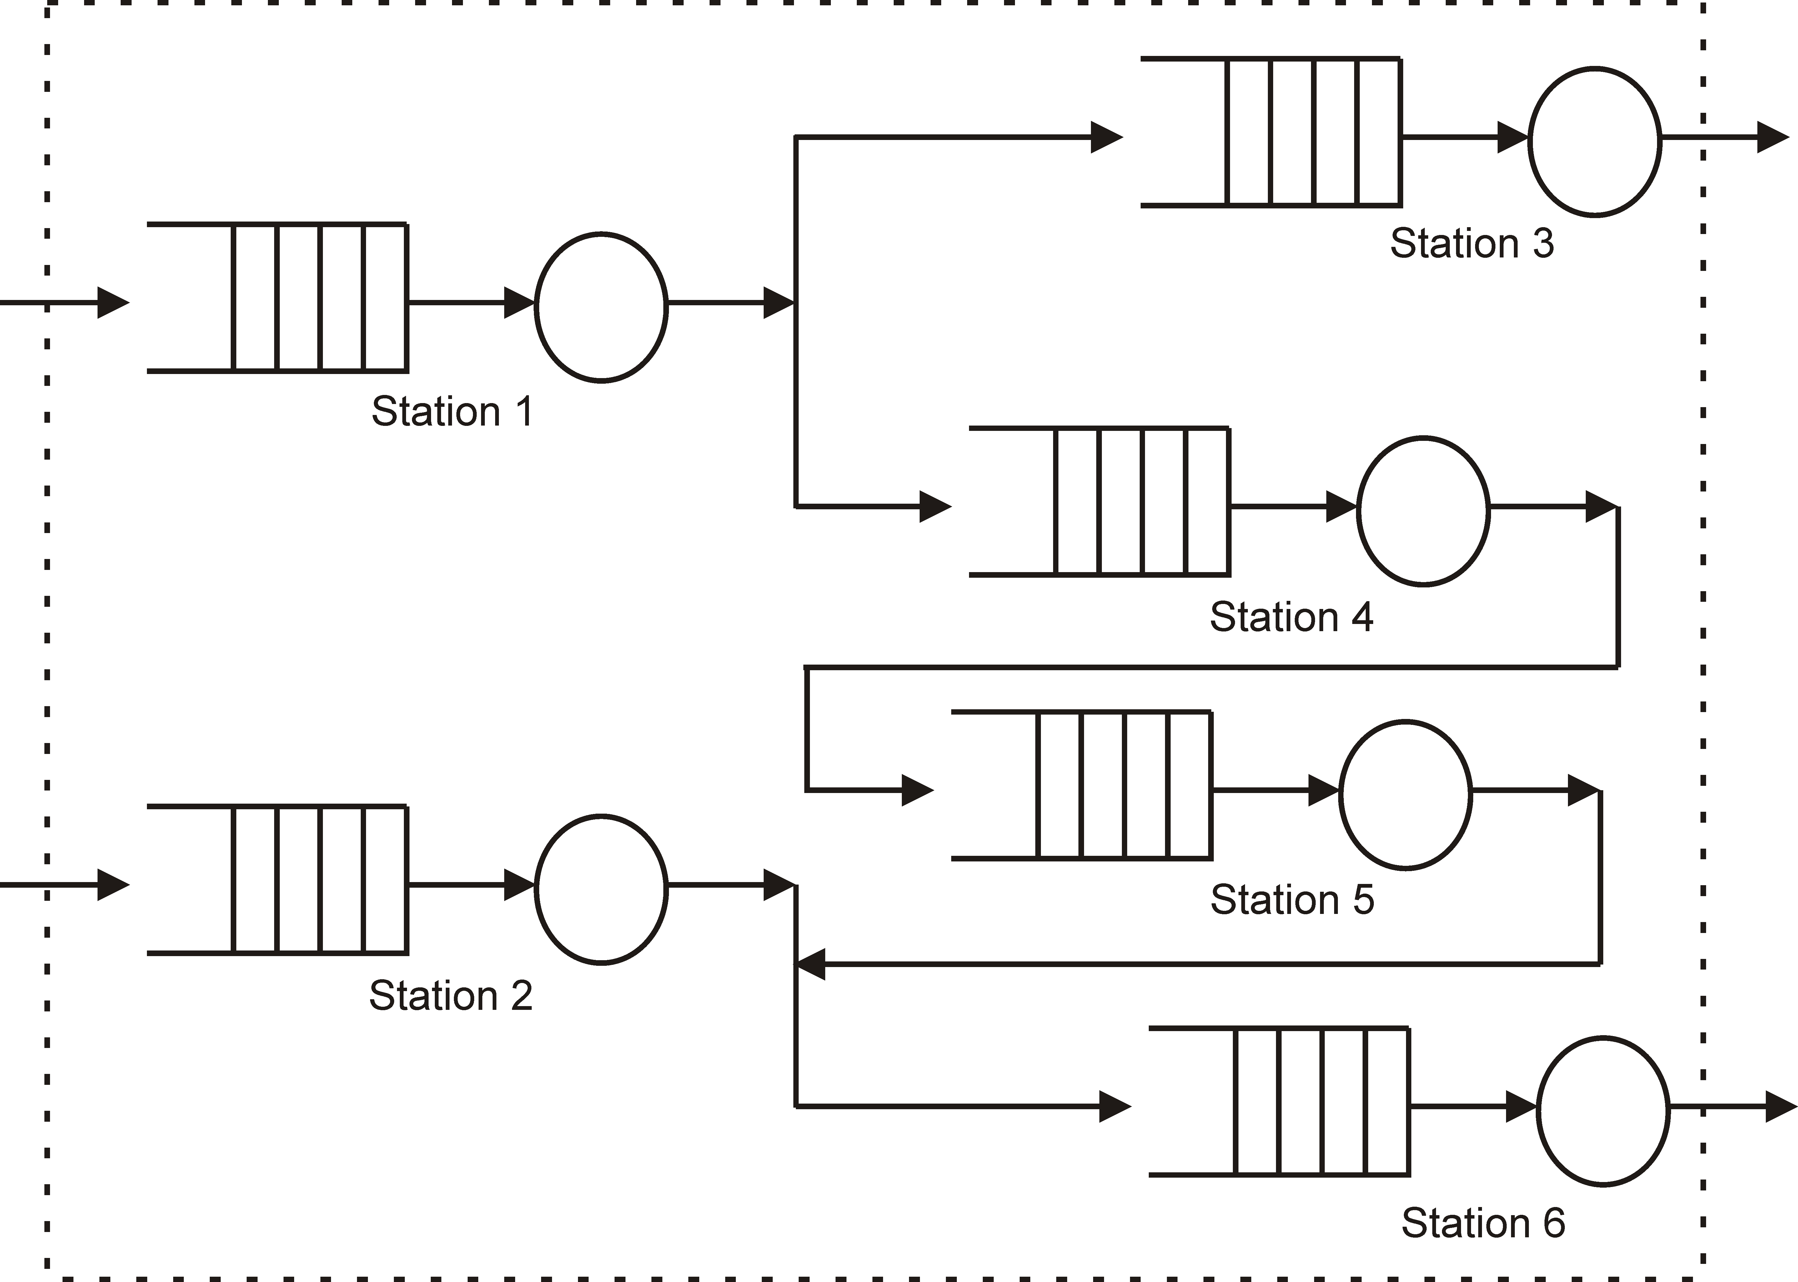
A Queuing Network Model with Six Stations
Object Oriented Simulation

Slide 4
Queuing Network Models
In queuing systems, customers request service from several service stations.
A customer object will usually request service from several service stations.
For example, in a data communication network the data packets are the customers and they travel from service station to service station until each packet reaches its final destination.
Object Oriented Simulation

Slide 5
Performance Metrics
Some of the performance measures to be computed for queuing models are:
For every server, the percentage of the total time that the server is carrying out the servicing of the customers, the server utilization
The average number of customers waiting (i.e., the number of customers in the queue)
The average time that a customer spends in the system, the average sojourn time
The total number of customers serviced in a given interval, the system throughput
The percentage of customers rejected because of the limited queue size. (These customers arrive when the queue is full.)
Object Oriented Simulation

Slide 6
Priorities
Customer Types
In models with multiple types of customers, each customer type has its mean arrival rate, mean service period, and other workload parameters.
Usually, each customer type is given a priority.
A priority is used by the server object to select a customer for service.
The server normally selects the customer with the highest priority.
The priority affects the order of removal from the queue—the queue discipline.
Object Oriented Simulation

Slide 7
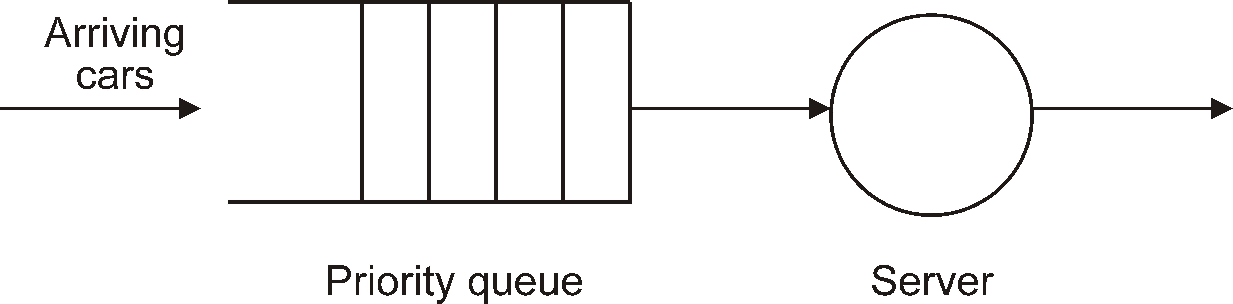
Model of a Simple System with Priorities
Object Oriented Simulation

Slide 8
Applications with Priorities
Real-time systems used to control power plants
Computer communication networks, in which data may be routed in different ways, according to the message priorities
Medical attention in a hospital, in which patients are attended according to the degree of the emergency
Operating systems, in which processes are serviced according to the process’ priority
Object Oriented Simulation

Slide 9
Priority Queues
Simulation models with priorities include at least one priority queue for arriving customers.
A priority queue is a queue that stores customers in order of priority and uses FIFO ordering for customers with the same priority.
Customers with the highest priority are always at the head of the queue. Computer communication networks, in which data may be routed in different ways, according to the message priorities
Object Oriented Simulation

Slide 10
Priorities With Single-Server Models
Customer objects of different types arrive and join a priority queue.
The priority is assigned by the arrivals object.
Since customer objects of the various types have different mean inter-arrival periods and different mean service periods, for each type of customers a different arrivals object is created.
Each arrival object creates customer objects of the same type.
Object Oriented Simulation

Slide 11
Process Priorities
The priority of a process is an integer value and represents its relative importance to other processes.
To access the priority of a process, the statement assign priority is used.
Object Oriented Simulation

Slide 12
Example Process Priorities
define mach_prio of type integer // priority of machine
define myprio of type integer define machine of class Server
...
// priority of self
// reference to server
assign priority of machine to mach_prio
assign priority to myprio // get priority self
Object Oriented Simulation

Slide 13
Set Priority of Active Object
To set the priority of a process, the statement fix priority is used. The general structure of the statement follows.
fix priority ( prio_var ) [ to ( ref_variable ) ]
Object Oriented Simulation

Slide 14
Example of Set Priority
The following example sets priority 5 to the current process, then it sets priority 1 to another process referenced by the machine.
fix priority 5 // to self fix priority 1 to machine
Object Oriented Simulation

Slide 15
Example 2 with Priority
The following example increases the priority of a process referenced by machine by 1. The code defines an integer variable m_priority to store the priority of the process.
define m_priority of type integer
...
assign priority of machine to m_priority
increment m_priority // increment current priority fix priority m_priority to machine // new priority
Object Oriented Simulation

Slide 16
Priority Queues
Priority queues allow the simulation model to retrieve or remove processes from the queue, based on the priority of the processes.
Priority queues do not behave as FIFO queues. A priority queue is an object of the class Pqueue.
Object Oriented Simulation

Slide 17
Example Creating Objects of Class Pqueue
The following lines of code declare and create the priority queue with reference name cust_queue, with queue name Customer Queue, using 8 different priorities, and size (capacity) of 25 customers for every priority.
define cust_queue of class Pqueue
...
// create priority queue
create cust_queue of class Pqueue using "Customer Queue", 8, 25
Object Oriented Simulation

Slide 18
Create Objects of Class Pqueue
Objects of class Pqueue are passive objects.
The constructor for creating a priority queue requires the name of the queue, the optional number of different priorities, and the queue size for all priorities, which is also optional.
If the second argument is not included, the number of priorities is assigned to 300 (default).
If the third argument is not included, the assigned default queue size is 1,000 for every priority.
Object Oriented Simulation

Slide 19
Priority Queue Length
This assign statement gets the current size (total number of processes) in the specified priority queue.
An integer value that corresponds to the current length of the queue is assigned to the specified integer variable.
The general structure of the statement follows.
assign the length of ( queue_ref ) to ( variable )
Object Oriented Simulation

Slide 20
Example Length of Priority Queue
For example, the following lines of code get the current length of priority queue cust_queue (defined above) and assign this value to variable mqlength.
define mqlength of type integer
...
assign length of cust_queue to mqlength
Object Oriented Simulation

Slide 21
Check Priority Queue Empty
The if statement with the empty condition checks if a queue is empty.
For example, the following lines of code check if queue object cust_queue (defined above) is empty.
The current process suspends itself if the queue is empty, otherwise, it proceeds to remove a process from the queue.
if cust_queue is empty then
// if queue is empty, suspend here suspend self
...
else
// dequeue process
...
endif
Object Oriented Simulation

Slide 22
Processes With A Specified Priority
The following line of code gets the current number of processes in the priority queue cust_queue, with priority l_prio, and assigns this number to variable num_proc.
assign length of cust_queue with priority l_prio to num_proc
Object Oriented Simulation

Slide 23
Insert Process Into Priority Queue
The insert (and enqueue) statement inserts the specified process into the priority queue.
The size of the queue is increased by one.
The priority of the process is automatically used to insert the process.
insert ( ref_variable ) into ( queue_ref )
insert self into ( queue_ref )
enqueue ( ref_variable ) into ( queue_ref )
enqueue self into ( queue_ref )
Object Oriented Simulation

Slide 24
Example Insert
The following lines of code insert (enqueue) process cust_obj
into priority queue pcust_queue.
define cust_prio = 3 of type integer define cust_obj of class Customer
...
// enqueue customer process insert cust_obj into pcust_queue
Object Oriented Simulation

Slide 25
Remove Process with Specified Priority
The statements remove and dequeue remove (dequeue) a process of a specified priority, from a priority queue.
After removal, the size of the queue is reduced by one, as a result of this operation.
remove [ object] ( ref_var ) of class ( cl_name )
from [ queue] ( queue_ref )
with priority ( prio_variable )
dequeue [ object] ( ref_var ) of class ( cl_name )
from [ queue] ( queue_ref )
with priority ( prio_variable )
Object Oriented Simulation

Slide 26
Example Remove Process
The following example removes (dequeues) a customer process from queue cust_queue and assigns a reference cust_obj to it, given priority cust_prio.
If no priority is specified, the statement removes the highest priority process from the priority queue.
define cust_prio of type integer
...
remove object cust_obj of class Customer from queue cust_queue with priority cust_prio
Object Oriented Simulation

Slide 27
Carwash with Priorities
Each car object includes its priority (type) in addition to its service period, as part of its relevant attributes.
A car object joins the car queue according to its priority.
The Arrivals object creates a sequence of car objects of a specified priority. One car object is created after every inter-arrival time interval.
Every car object has a different service interval.
Object Oriented Simulation

Slide 28
Multi-Server Models with Priorities
There are several car types, each with a specified priority
There are several objects of class Arrivals, each one generates car objects of the specified type
Each server dequeues and services the car with the highest priority
A different configuration has each server servicing cars of a specified type
Object Oriented Simulation

Slide 29
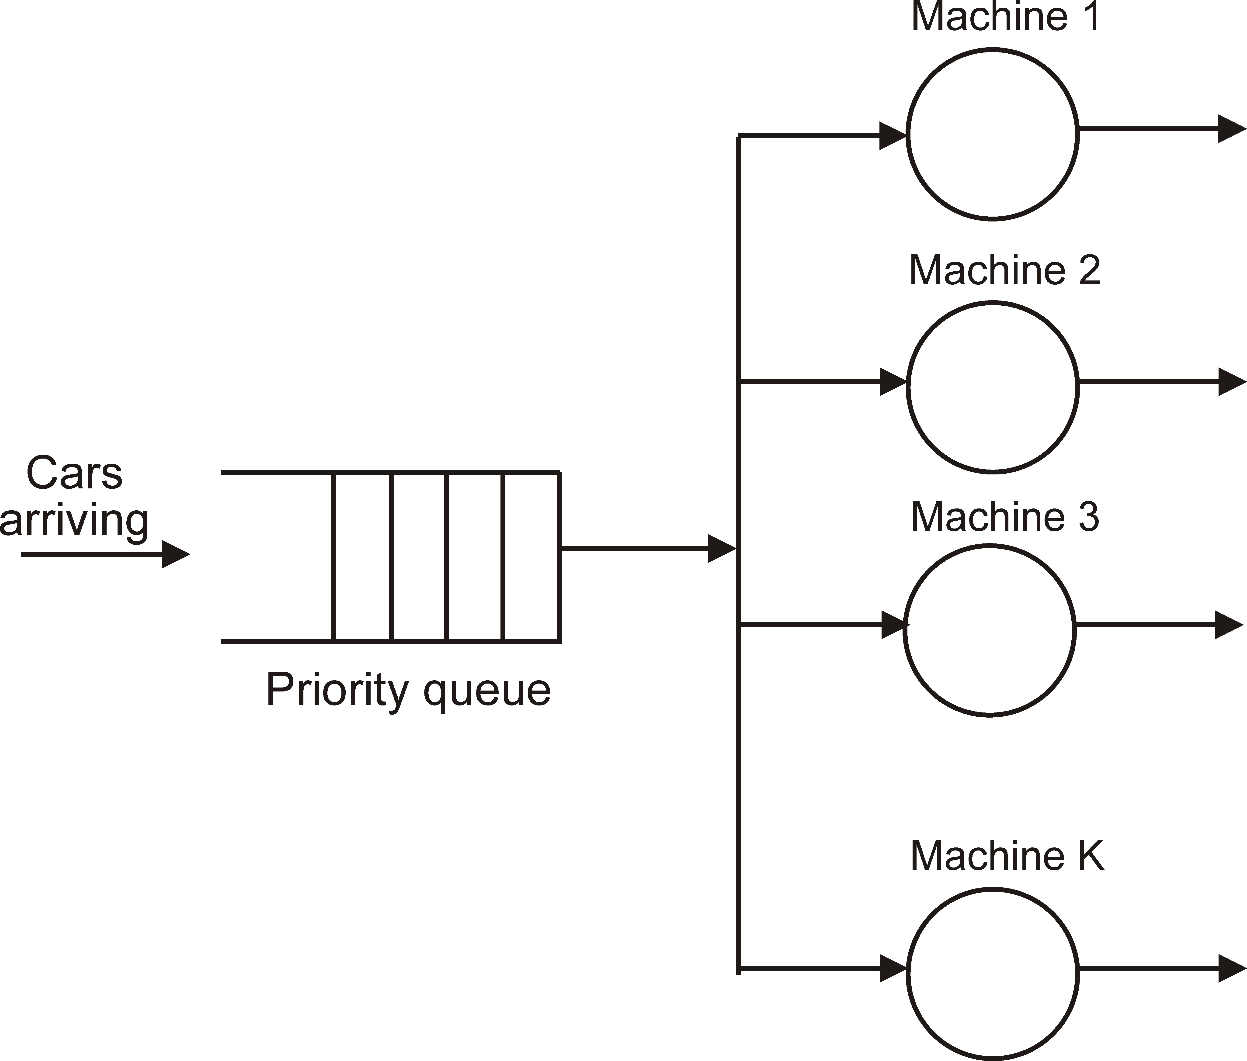
Model of a Multi-Server System with Priorities
Object Oriented Simulation

